Slide 1

Bank Transaction Analysis System
By: [SOURABH ARYA]

Slide 2
This project analyzes bank transaction data to uncover: - Transaction patterns - Customer behavior - High-value transactions
Project Overview

Slide 3

Dataset Information: The dataset contains the following field
- Transaction id
- Account id
- Amount
- Transaction type
- City
- Transaction date

Slide 4
Overall Transaction Summary
Total Transactions: 1,500
Total Amount: ₹ 74,509,993
The dataset contains a high volume of transactions with significant total value.

Slide 5
Credit vs Debit Distribution
Credit transactions are slightly higher than debit transactions (52% vs 48%).

Slide 6
City-wise Transaction Analysis
Insights:- Certain cities have higher transaction counts and total amounts, indicating strong financial activity.

Slide 7
Account Balance Analysis
Description:- This analysis calculates the net balance of each account by considering credit and debit transactions.
Insights:- Some accounts show negative balances, indicating higher debit transactions than credits.

Slide 8
Top 5 Customers
Insight:- These top 5 customers have the highest net balances due to consistently high-value credit transactions and relatively fewer debits.

Slide 9
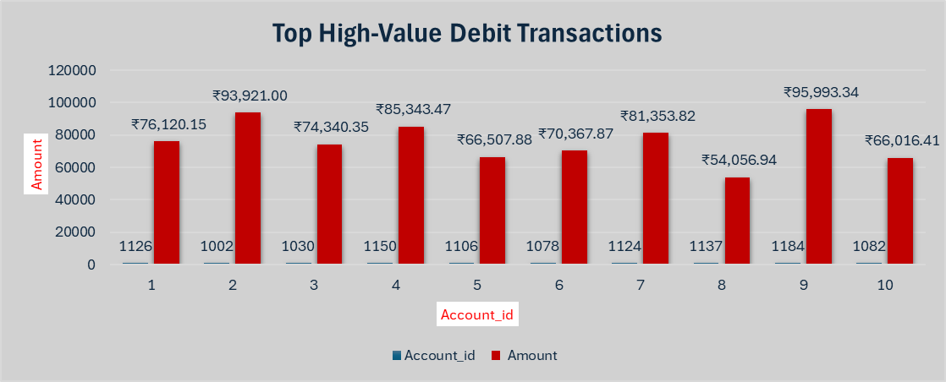
High-Value Transactions Analysis
Description:- This analysis highlights high-value debit transactions exceeding ₹50,000.
Insight:- High-value debit transactions indicate large expenditures and may require monitoring.

Slide 10
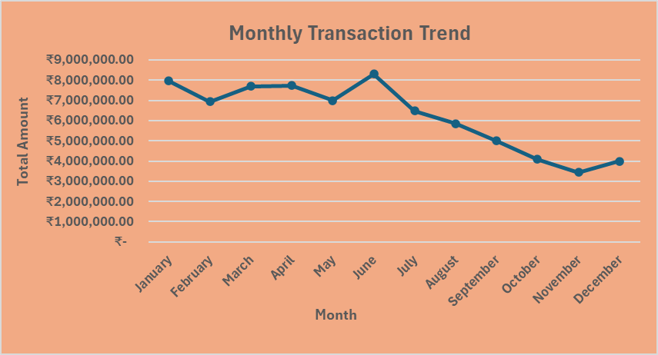
Monthly Transaction Trend
Description:- This analysis shows how transaction amounts vary across different months.
Insight:- Transaction activity peaks around mid-year and gradually declines towards the end of the year, indicating seasonal behavior.

Slide 11
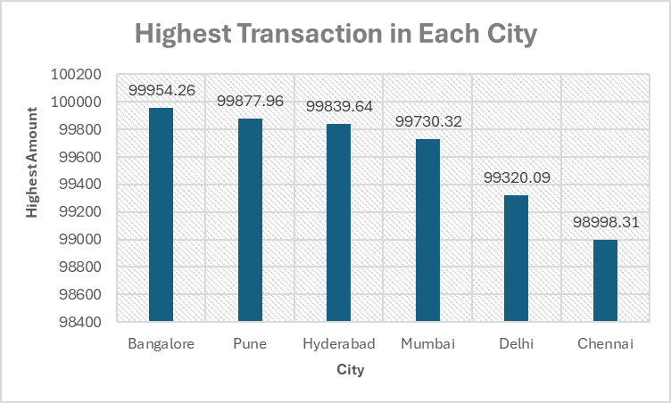
Highest Transaction by City
Description:- This analysis identifies the highest transaction recorded in each city.
Insight:- Some cities have significantly higher peak transactions, indicating higher financial activity and large-value operations.

Slide 12
Top 3 Transactions per City
City | Amount | Rank
Bangalore | ₹ 99,954.26 | 1
Bangalore | ₹ 99,389.91 | 2
Bangalore | ₹ 99,308.03 | 3
Chennai | ₹ 98,998.31 | 1
Chennai | ₹ 98,703.11 | 2
Chennai | ₹ 96,988.65 | 3
Delhi | ₹ 99,320.09 | 1
Delhi | ₹ 99,315.50 | 2
Delhi | ₹ 99,159.89 | 3
Hyderabad | ₹ 99,839.64 | 1
Hyderabad | ₹ 99,386.93 | 2
Hyderabad | ₹ 99,163.66 | 3
Mumbai | ₹ 99,730.32 | 1
Mumbai | ₹ 99,330.23 | 2
Mumbai | ₹ 99,266.70 | 3
Pune | ₹ 99,877.96 | 1
Pune | ₹ 99,324.48 | 2
Pune | ₹ 98,936.94 | 3
Description:- This analysis identifies the top 3 highest transactions in each city.
Insight:- Top transactions highlight major financial activities and high-value spending patterns across different cities.

Slide 13
Key Insights & Conclusion
- Total transactions show a high volume of financial activity in the dataset
- Credit and Debit transactions are relatively balanced
- Some cities contribute more to total transaction value, indicating higher activity
- High-value transactions highlight major financial movements
- Monthly trends show fluctuations, suggesting seasonal behavior
- Top transactions per city reveal key spending patterns
This analysis helps in understanding customer behavior and financial trends, which can support better decision-making in banking systems.

